Slide 1
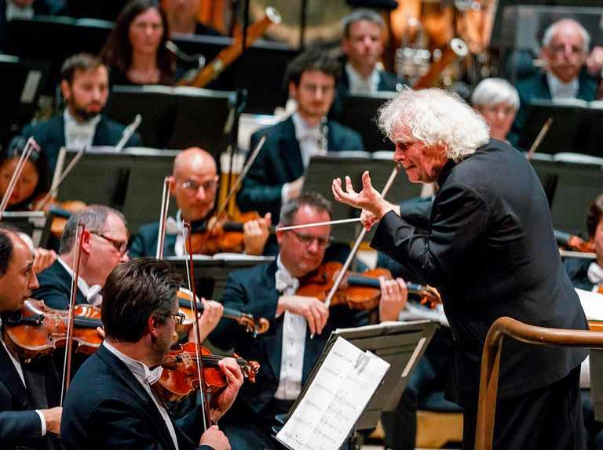
The Orchestra
Kenny Lim

Slide 2

Voices sections
Woodwinds
Brasswinds
Strings
Percussion
Keyboard

Slide 3
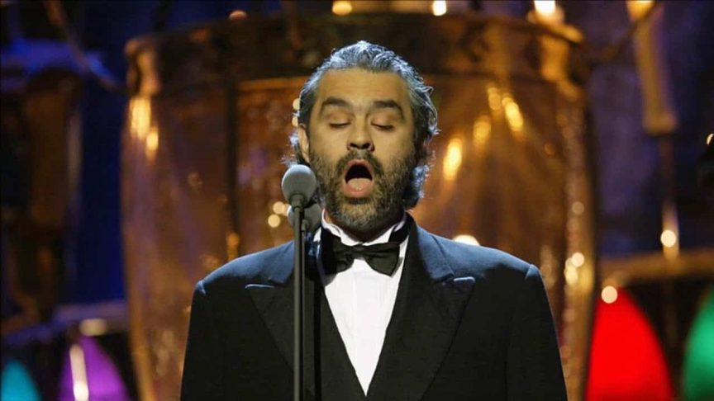
Basic vocal types
Soprano
Alto
Tenor
Bass
Notes:
Ask student to sing a triad

Slide 4
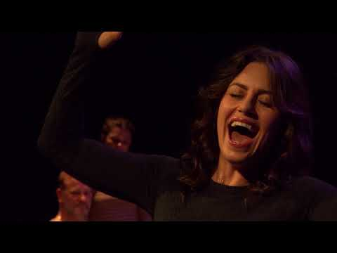

Slide 5
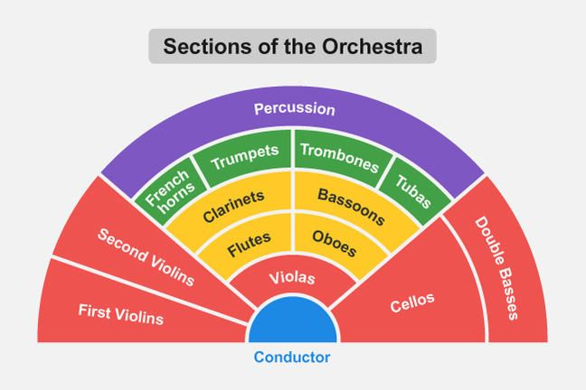

Slide 6
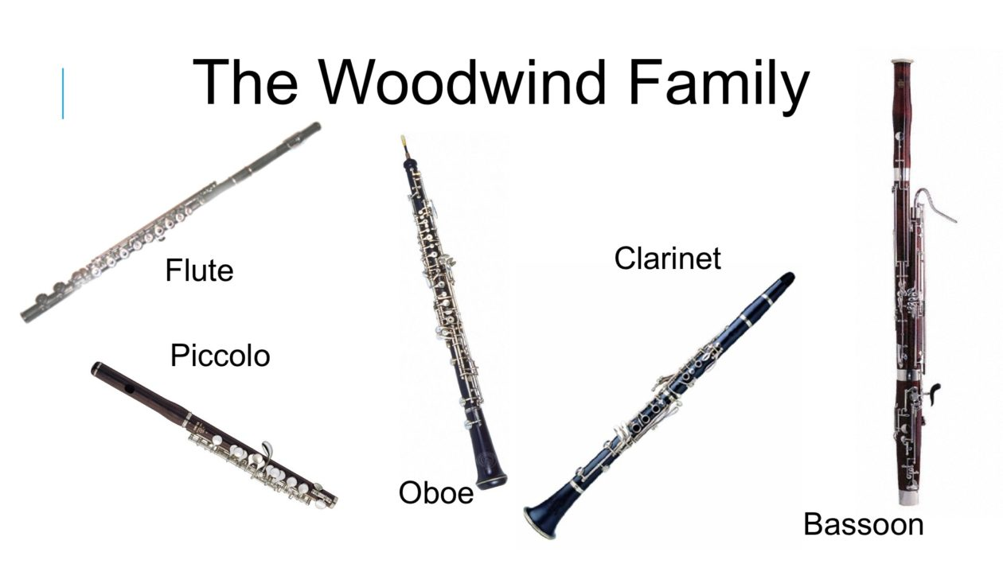
Woodwind Family
Three types of woodwind instrument:
Single Reed
Double Reed
No Reed

Slide 7
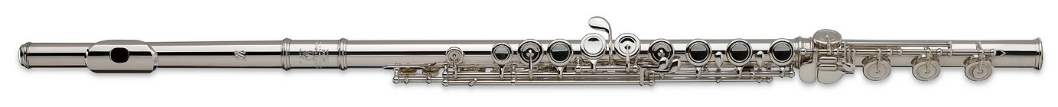
Flutes
Traditionally made of wood
Modern flutes are made of precious metals such as silver and gold
Does not require a reed to produce sound
Vibration through the column of air produces sound

Slide 8


Slide 9
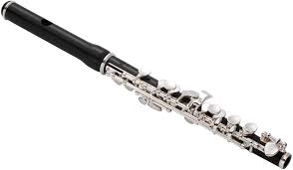
Piccolo
Made of wood
Highest pitched woodwind instrument
Has a penetrating tone color that can project though the orchestra

Slide 10
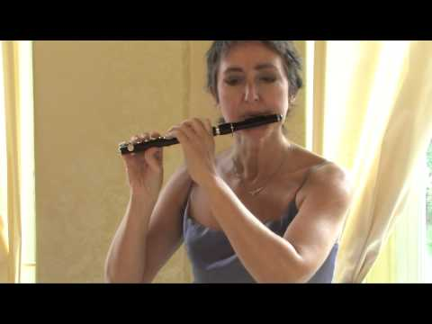

Slide 11
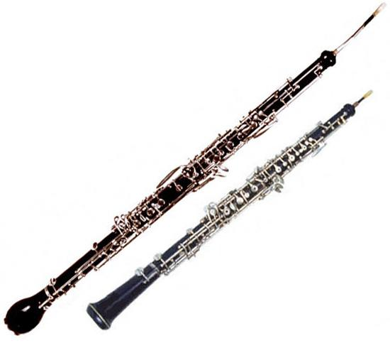
Oboe & Cor-anglais/ English Horn
Double reed instrument
Made of wood
Vibration of the double reed produces sound

Slide 12
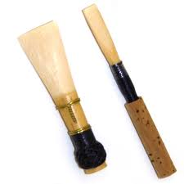
Oboe reed (Thin)
Bassoon reed (Wider)

Slide 13
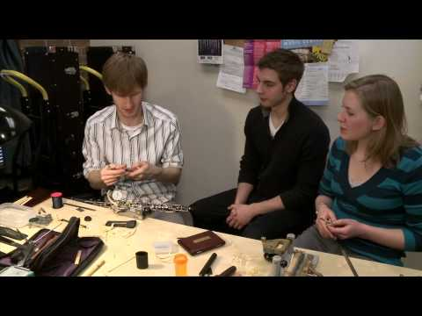

Slide 14
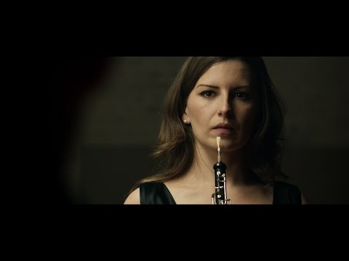

Slide 15
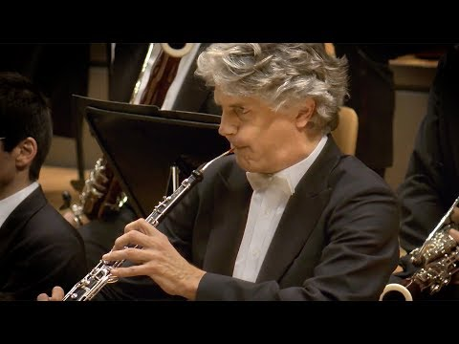

Slide 16
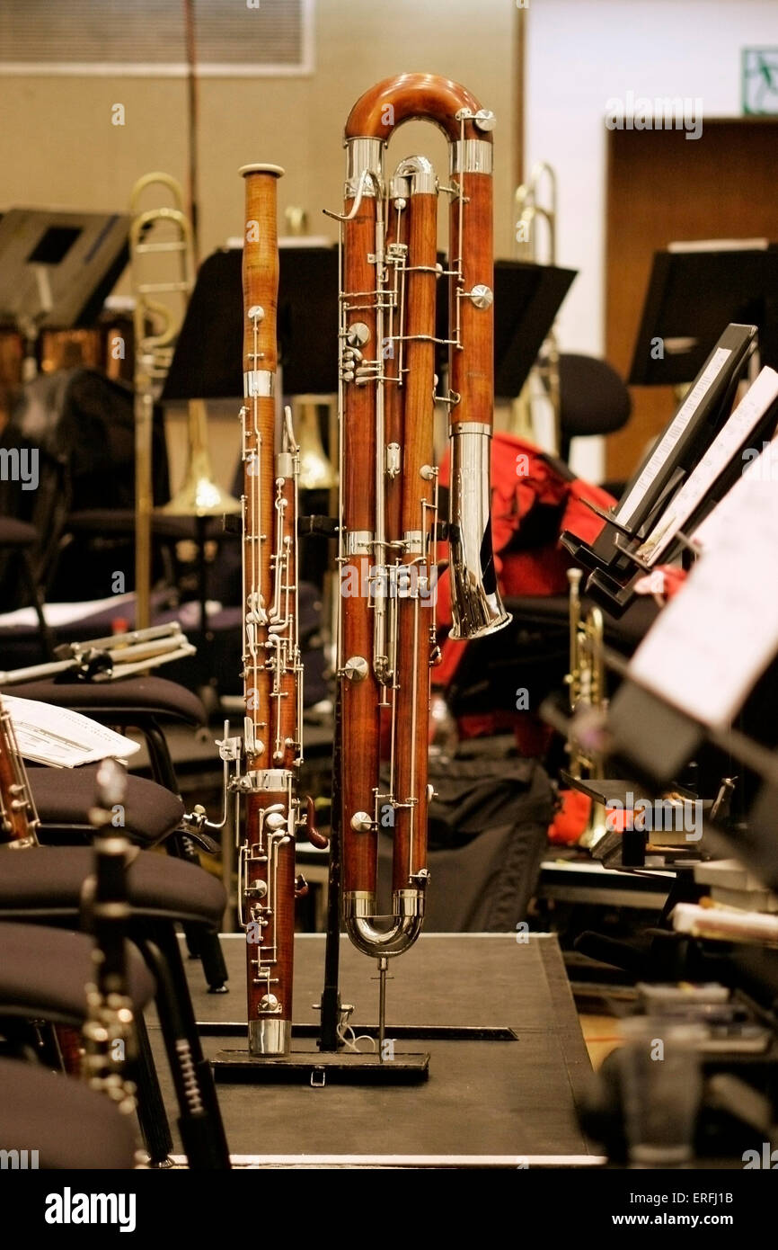
Bassoon & Contra-Bassoon
Double reed instrument
Made of wood
Plays in the lower pitch range

Slide 17
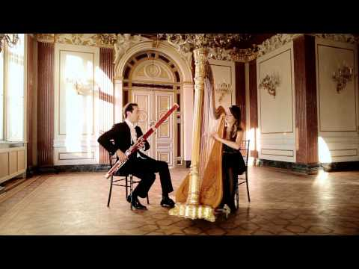

Slide 18
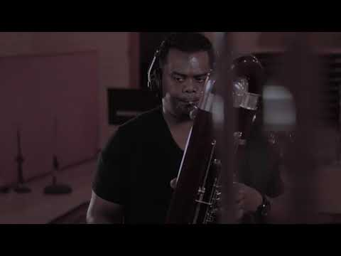

Slide 19
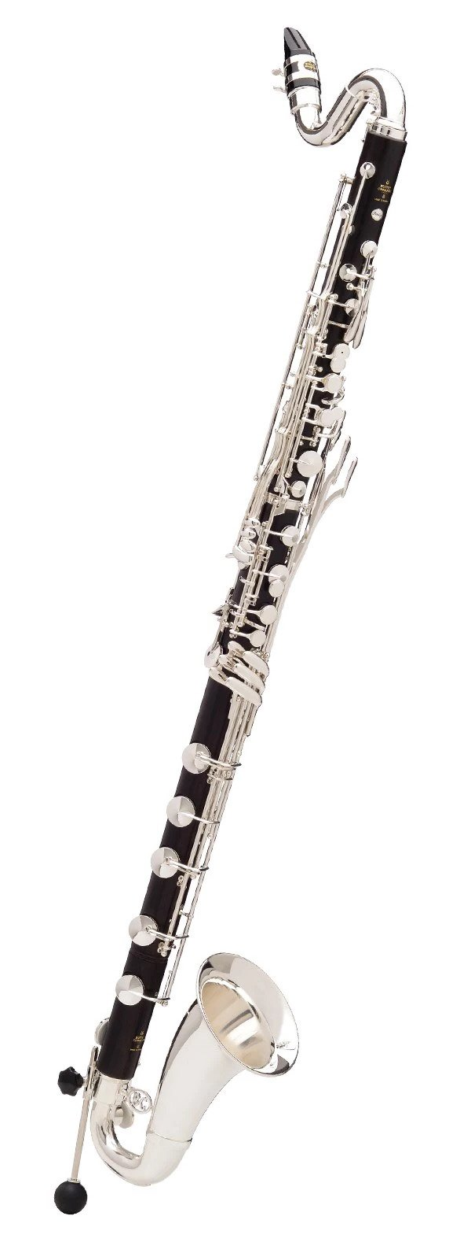
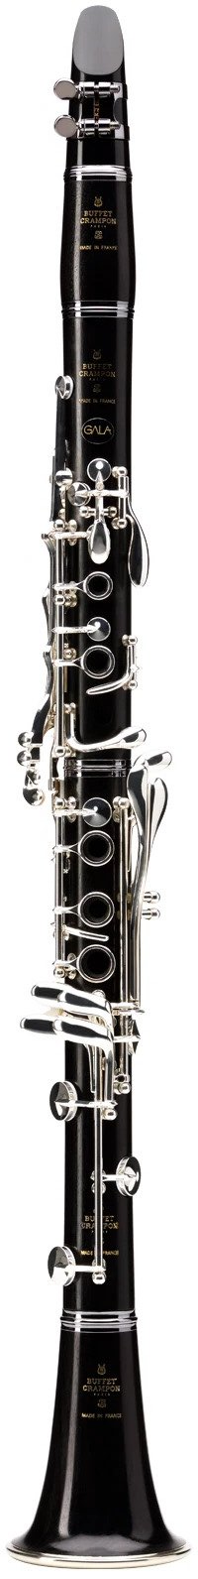
Clarinet & Bass Clarinet
Single reed instrument
Requires a mouthpiece
The reed will vibrate against the mouthpiece to produce a sound

Slide 20
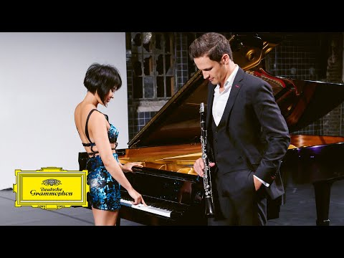

Slide 21
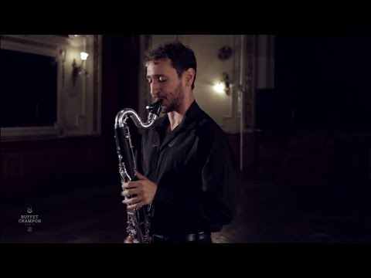

Slide 22
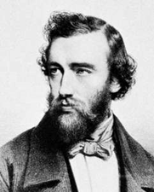
Saxophone
Single reed instrument
Invented by Adolph Sax
Modeled after the Clarinet

Slide 23
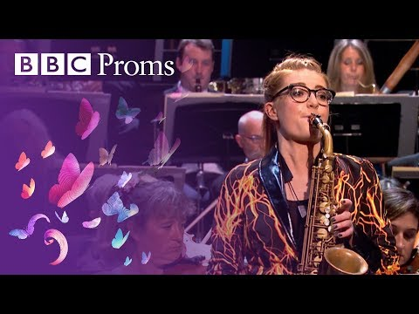

Slide 24
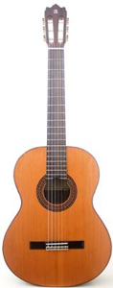
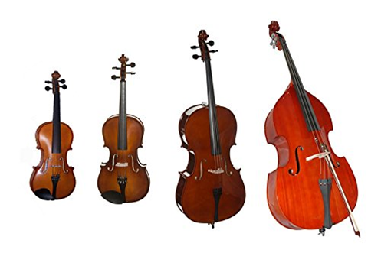
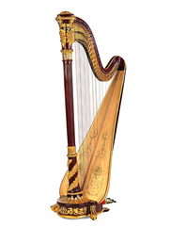
Strings Family

Slide 25
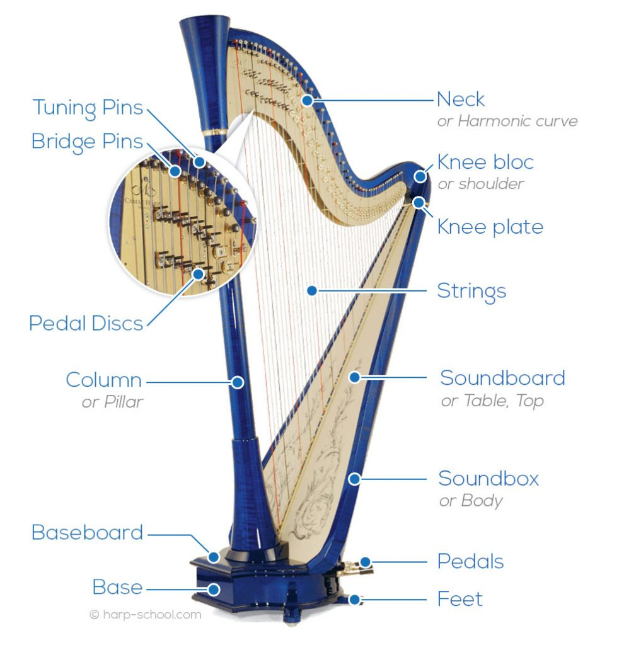
Harp
Modern harp has 47 strings and 7 foot pedals.
Pedals are used to raise the string’s pitch by semitone/tone.

Slide 26
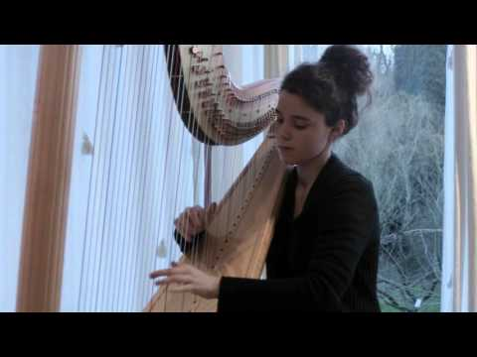
Harp

Slide 27
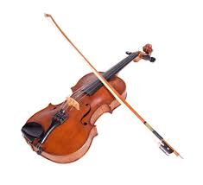
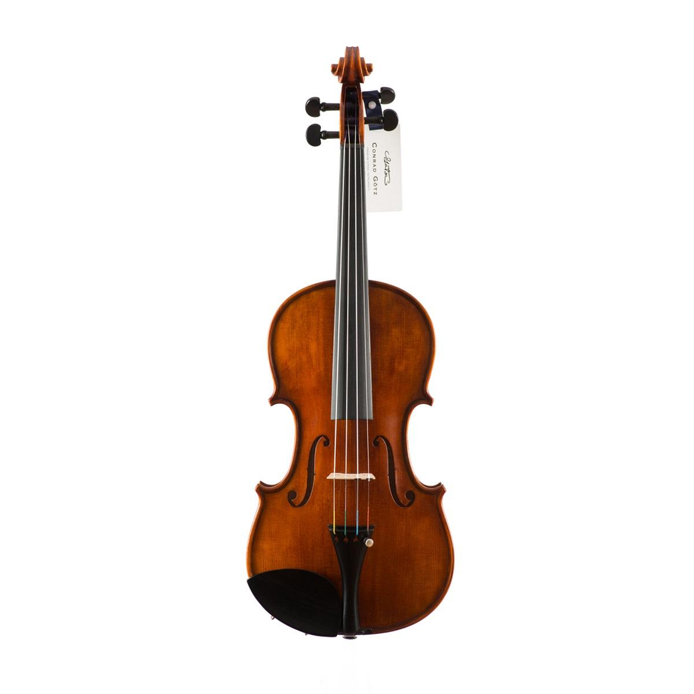
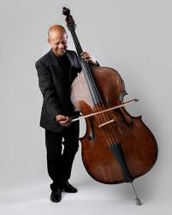
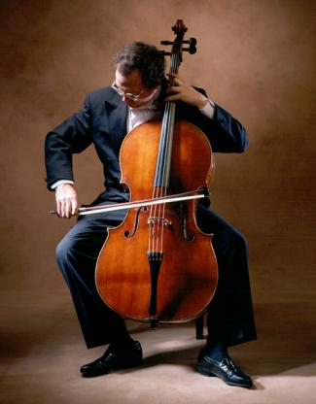
Violin
Viola
Strings Section in the Orchestra
Cello
Double Bass

Slide 28
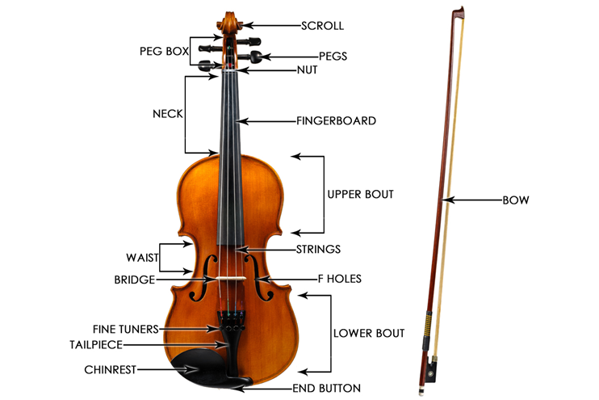

Slide 29
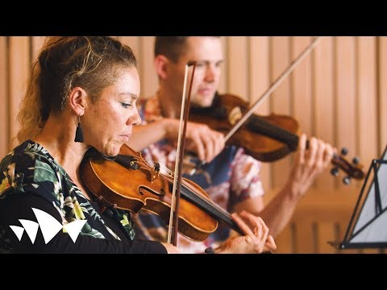

Slide 30
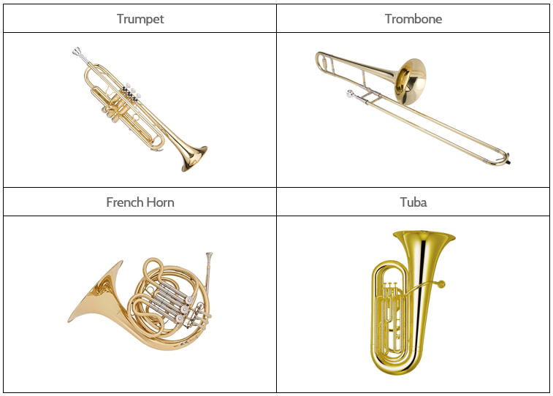
Brass winds
Uses a technique known as “buzzing”
Vibration produce by the performers lip tension that sets the column of air in motion.
Most brass instruments uses a mechanism known as valves
Trombone uses a mechanism known as slide

Slide 31
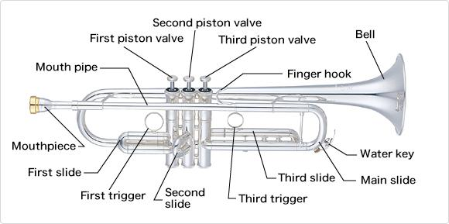
Trumpet
Highest pitch in the family
Bright tone color
Uses piston valve

Slide 32
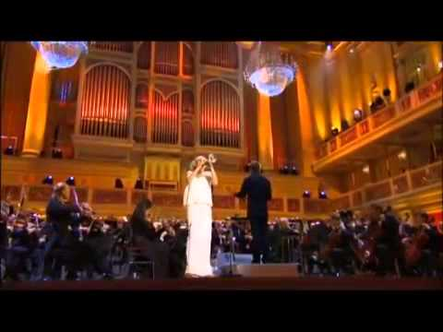

Slide 33
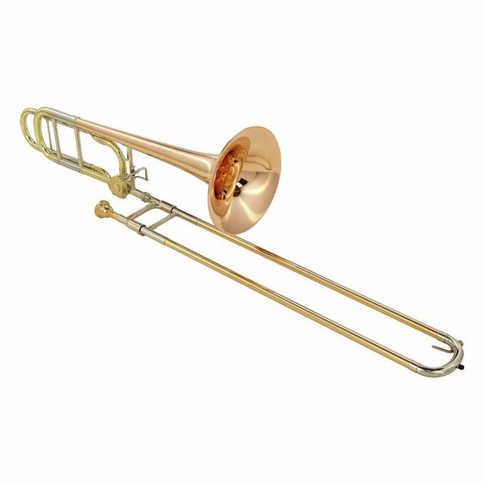
Trombone
Trombone uses a mechanism known as slide

Slide 34
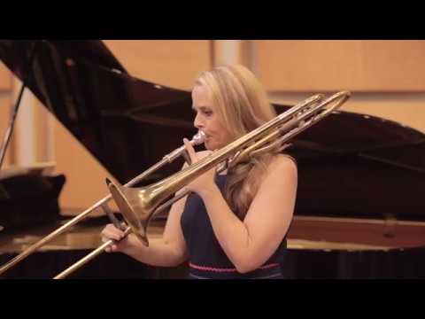

Slide 35
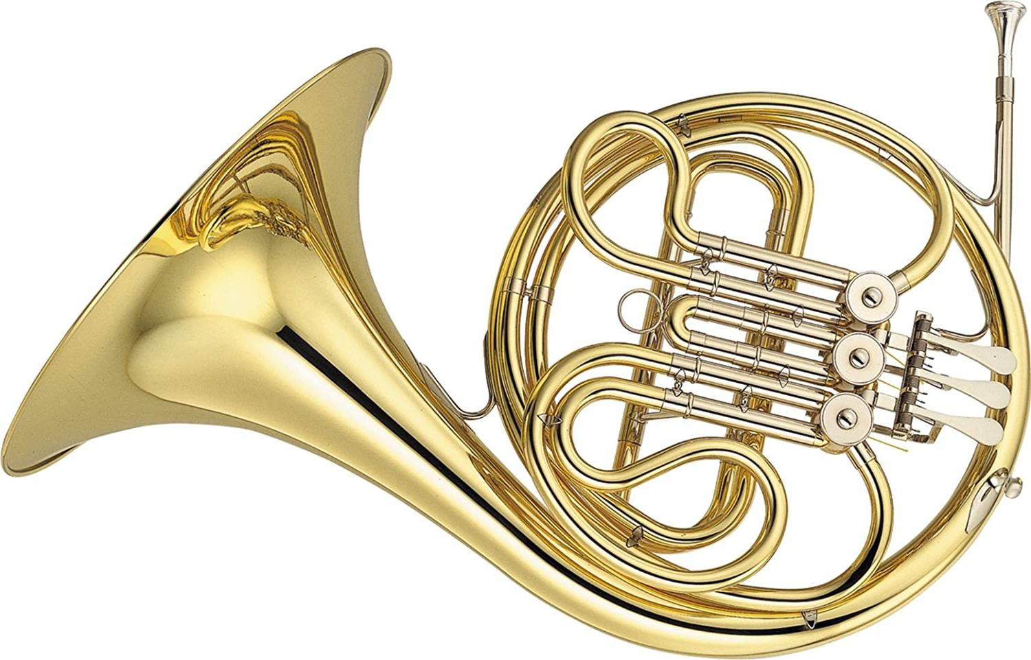
French Horn
Uses rotary valves
Horn player will hold the instrument with their right hand in the bell

Slide 36
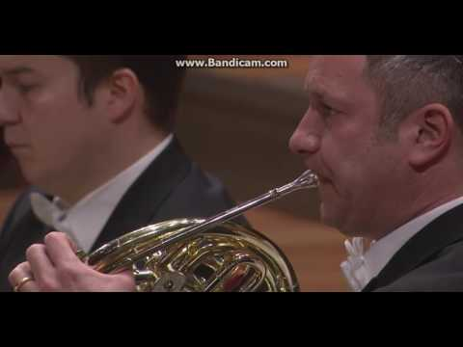

Slide 37
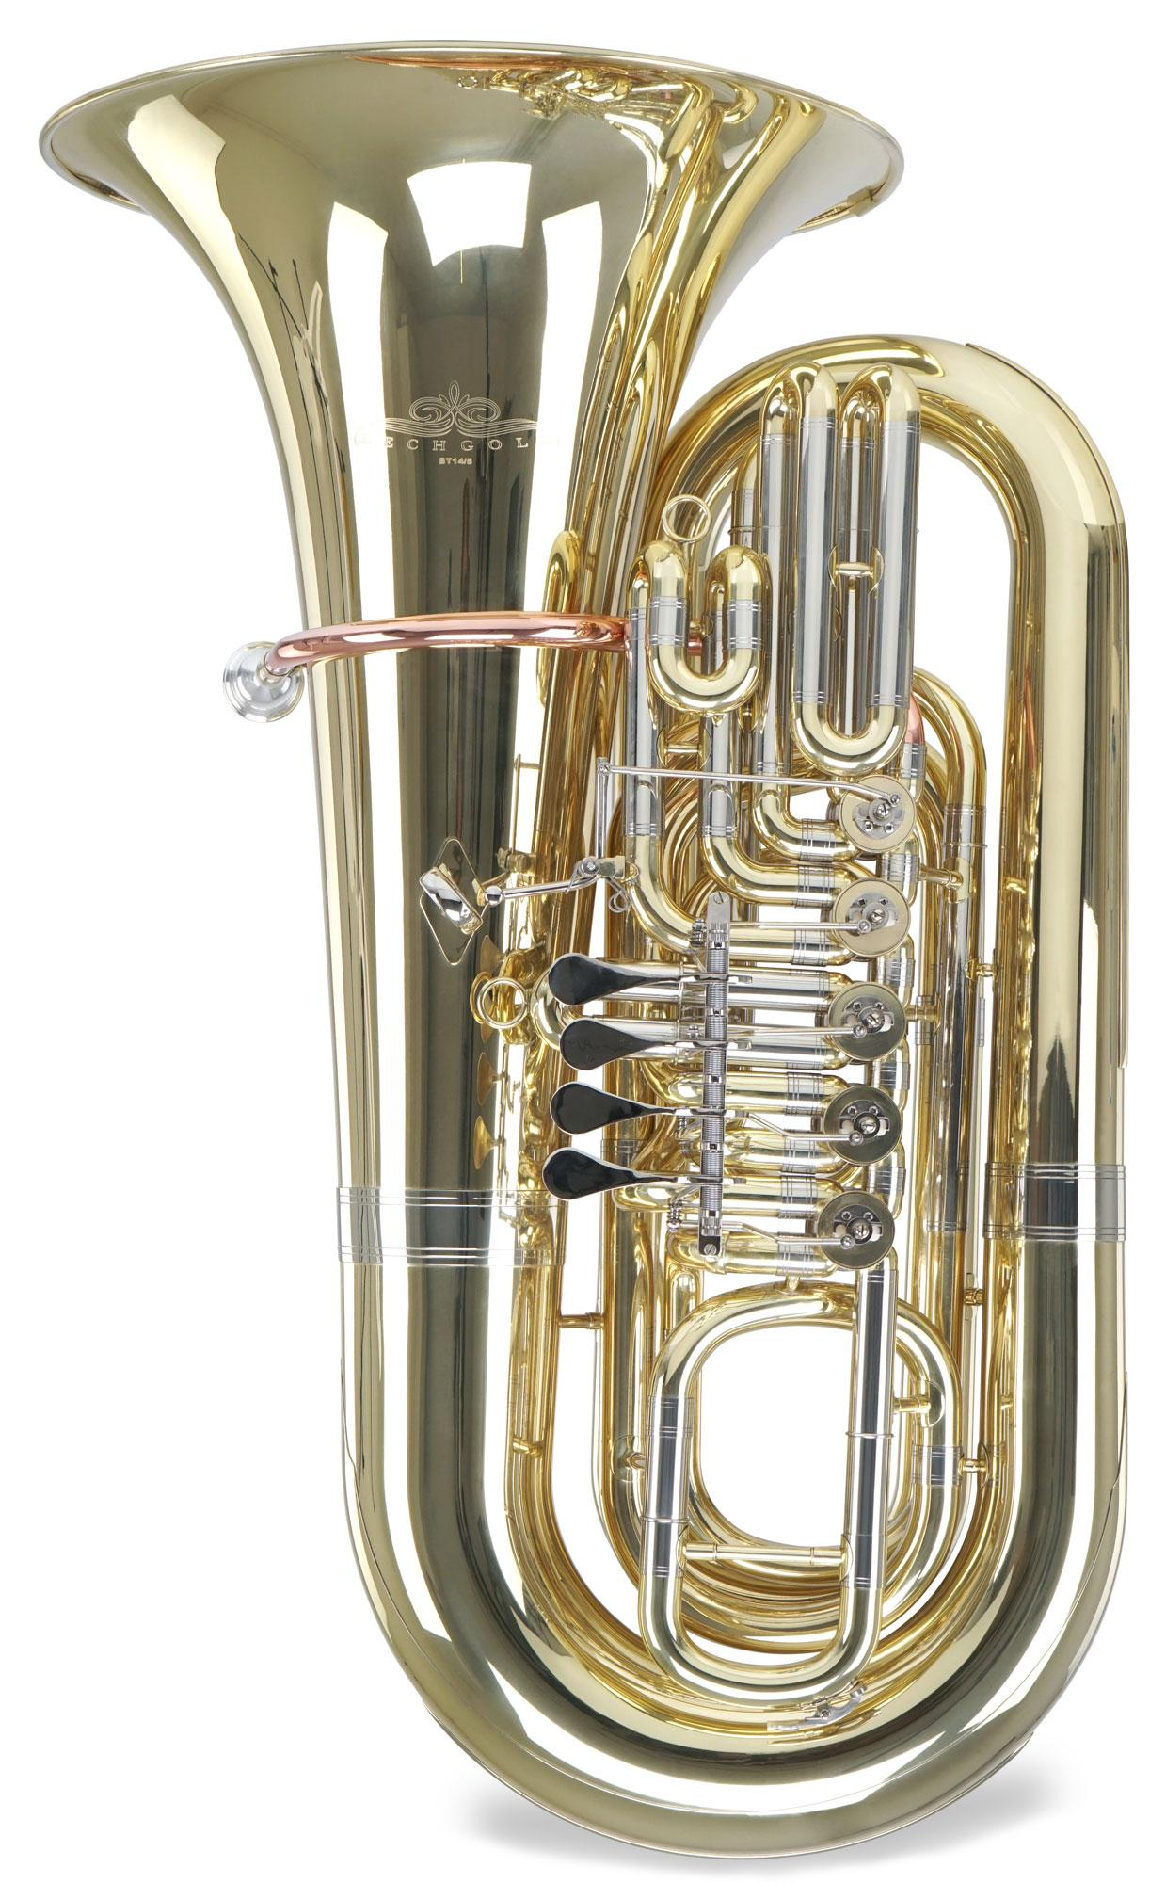
Tuba
The bass in brass family.

Slide 38
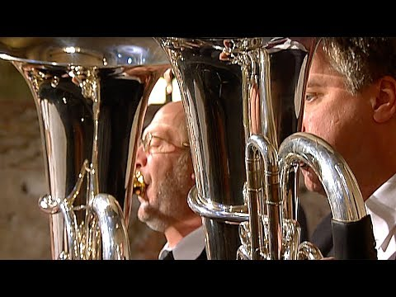
Notes:
Die Irae: Associated to death

Slide 39
Percussion
Vibration produces sounds of definite or indefinite pitch percussion when the instrument is shaken or struck
Definite Pitch | Indefinite Pitch
Timpani (Kettledrums) | Snare Drum (Side drum)
Glockenspiel | Bass Drum
Xylophone | Tambourine
Chimes | Triangle
Marimba | Cymbals
Vibraphone | Gong

Slide 40
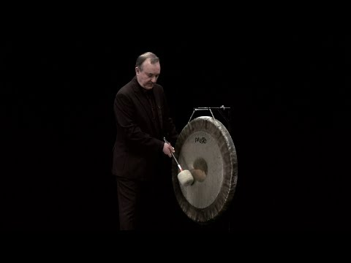

Slide 41
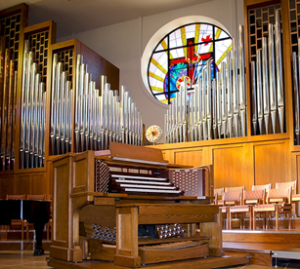
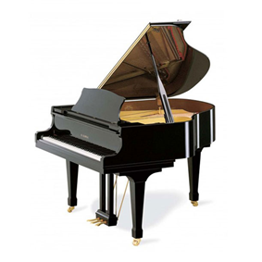
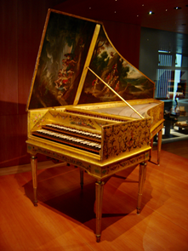
Keyboard
Pipe Organ
Piano
Harpsichord

Slide 42
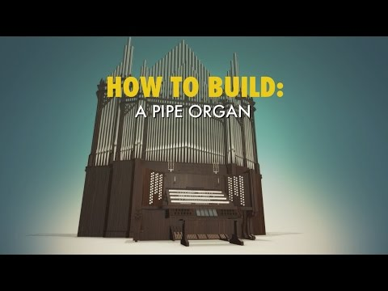

Slide 43
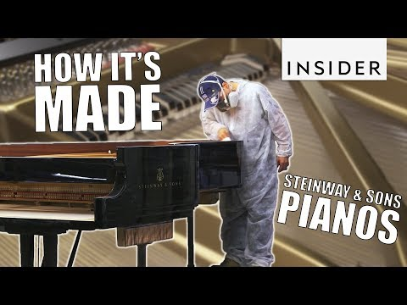

Slide 44
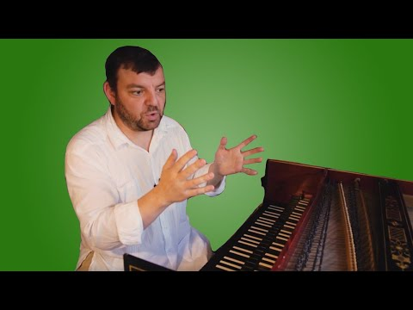

Slide 45
Difference between three keyboard instruments
Organ produces sound by driving pressurised air through the organ pipes
Piano produces sound with the felt hammer hitting the strings
Harpsichord produces sound by using a mechanism known as plectrum to pluck the strings

Slide 46
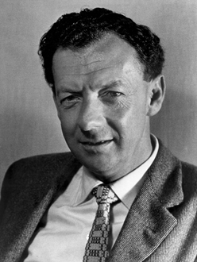
Benjamin Britten (1913 - 1976)
English composer, conductor and pianist
Figure of 20th century British music
Known for various works, especially his english operas.
The young person’s guide to the orchestra (1943)
Composed for a documentary film in 1946

Slide 47


